Slide 1
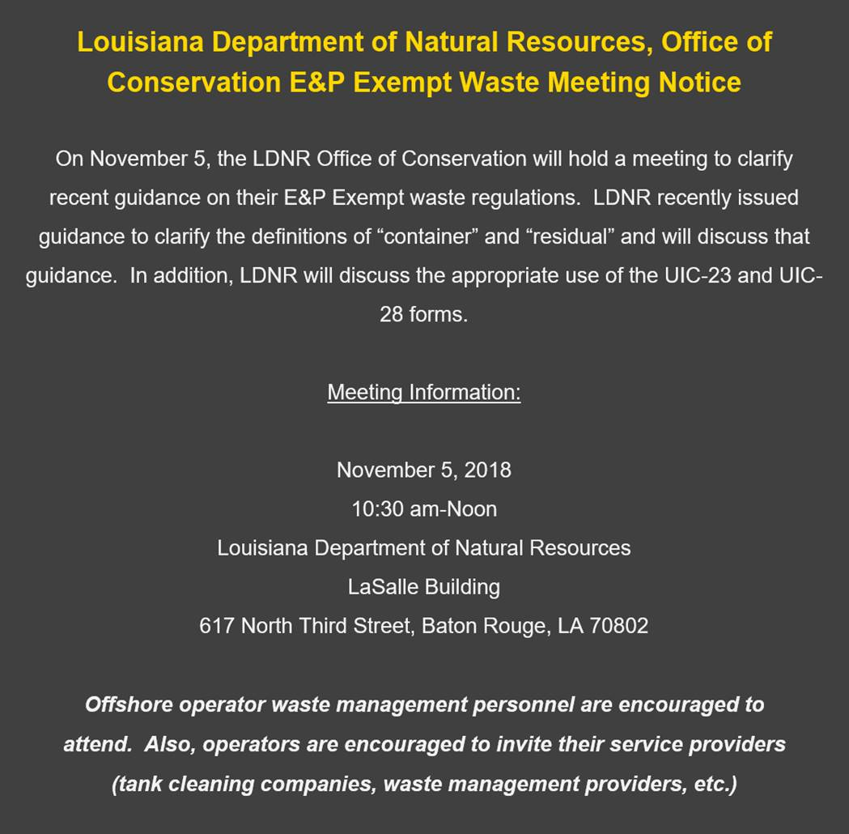

Offshore Operators Committee Meeting
Regulatory Guidance for
ENV-GS-2018-01, UIC 23 & UIC 28
Offshore Operators Committee Request
Regulatory Guidance
  “Residual” and “Container” Clarification
  Form UIC 23 Permit No. (Temp. Gen. Code)
  Form UIC 28 Waste Manifest
Not a Public Meeting for Rule Making

Slide 2
E&P Waste Generator Responsibilities
LAC 43:XIX.503
LAC 43:XIX.503.D
The generator is responsible for the proper handling and transportation of E and P Waste taken offsite for storage, treatment, or disposal to assure its proper delivery to an approved commercial facility or transfer station or other approved storage, treatment or disposal facility. Failure to properly transport and dispose of E and P Waste shall subject the generator to penalties provided for in R.S. 30:18. Each shipment must be documented as required by LAC 43:XIX.545 (Manifest System)

Slide 3
E&P Waste Definition
LAC 43:XIX.501
Drilling wastes, salt water, and other wastes associated with the exploration, development, or production of crude oil or natural gas wells and which is not regulated by the provisions of, and, therefore, exempt from the Louisiana Hazardous Waste Regulations and the Federal Resource Conservation and Recovery Act, as amended.

Slide 4
LAC 43:XIX.501
DNR Disposal Facility Definitions
Commercial Facility is defined, in part, as “a legally permitted E&P Waste storage, treatment and/or disposal facility which receives, treats, reclaims, stores, and/or disposes of E&P Waste for a fee or other consideration.”
Transfer Station is defined as “an E&P Waste receiving and storage facility, located offsite, but operated at an approved location in conjunction with a permitted commercial facility, which is used for temporary storage of manifested E&P Waste for a period of 30 days or less.”
Generator is defined as “any person or entity who generates or causes to be generated any E&P Waste.”
Residual is defined as the de-minimis quantity of E&P waste remaining in a container after offloading, using practices commonly employed to remove materials from that type of container (pouring, pumping, and aspirating) and amounting to no more than one inch of residue remaining on the bottom, or no more than three percent by weight of the total capacity of the container if the container is less than or equal to 110 gallons in size, or no more than 3% by weight of the total capacity of the container if the container is greater than 110 gallons in size.

Slide 5
Intra-office guidance statement
ENV-gs-2018-01

Slide 6
E&P Waste Generator Responsibilities
LAC 43:XIX.503
LAC 43:XIX.503.D
The generator is responsible for the proper handling and transportation of E and P Waste taken offsite for storage, treatment, or disposal to assure its proper delivery to an approved commercial facility or transfer station or other approved storage, treatment or disposal facility. Failure to properly transport and dispose of E and P Waste shall subject the generator to penalties provided for in R.S. 30:18. Each shipment must be documented as required by LAC 43:XIX.545 (Manifest System)

Slide 7
E&P Waste Generator Responsibilities
LAC 43:XIX.503
LAC 43:XIX.503.A.1
Generators of E and P Waste must be familiar with the components of the E and P Waste they generate.
LAC 43:XIX.503.B
The unpermitted or unauthorized onsite or offsite storage, treatment, disposal or discharge of E and P Waste is prohibited and is a violation of these rules.

Slide 8
E and P Waste Manifest System
LAC 43:XIX.545
In order to adequately monitor the movement and disposal of E and P Waste, every
Shipment of E and P Waste transported to a commercial facility or transfer station
shall be accompanied by a manifest entitled “E and P Waste Shipping Control
Ticket.” It is expressly forbidden to transport or accept E and P Waste without a
properly completed manifest form,…

Slide 9
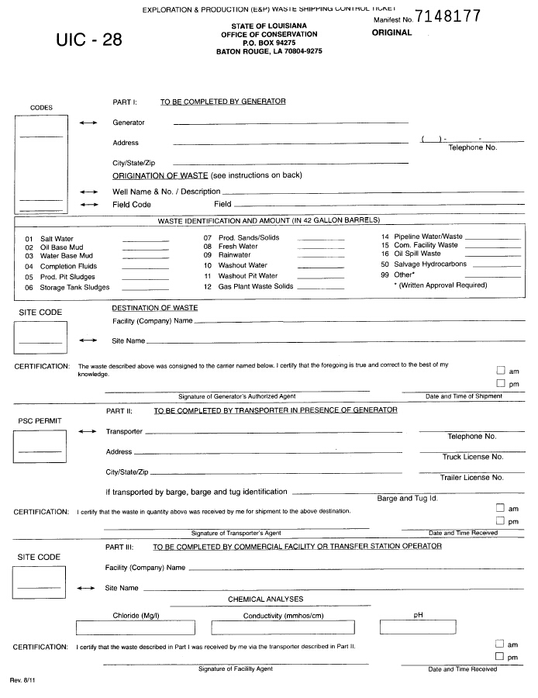
Original
White Form
Origination & Description of E&P Waste
Disposal Facility Retains Original Form for a Period of no less than three years
9

Slide 10
Form uic 28 instructions

Slide 11
UIC-28 Manifest Tickets
Generator Copy No. 2
Disposal Facility completes Part III,
mails back yellow copy to Generator
Transporter Copy
Transporter retains pink copy once disposal facility has signed, Part III
Generator retains green copy once generator & transporter have signed, Parts I & II
Generator Copy No. 1
Original
All action takes place on the original; remember signatures.
11

Slide 12
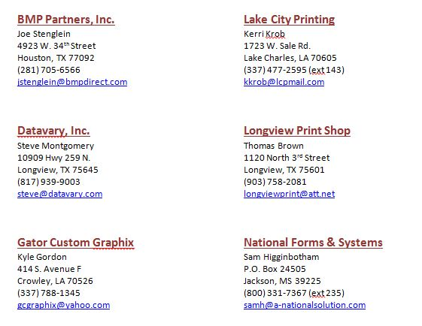
LAC 43:XIX.545
Approved UIC-28 Manifest Printing Companies
12

Slide 13
FORM UIC 23
LAC 43:XIX.545.B
For companies who do not possess an Office of Conservation operator code number, Form UIC 23 (or latest revision) must be approved prior to transporting E and P Waste (Including Waste Type 99) to a commercial facility or transfer station.
i.e. Cleaning Companies, Land Owners
Approval is granted on a case-by-case basis and is generally job specific
Fee – $150

Slide 14
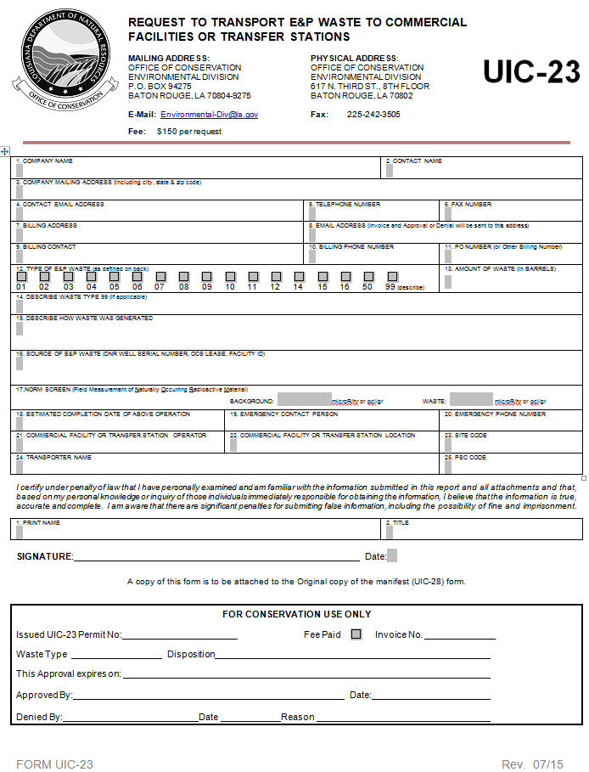
UIC-23
14

Slide 15
Uic 23 instructions

Slide 16
Uic 23 fee $150

Slide 17
Questions pertaining to dnr guidance document env–gs-2018-01
What are the agency’s plans for future regulations amendment?
When are Forms UIC 28 and 23 required?
Are used fluids that are being reclaimed (e.g. at a mud plant) considered exempt waste? What are the paperwork requirements?
Marine vessel tanks typically have a common piping system for all tanks and wash water gets circulated throughout the entire system. Is wash water used to clean marine vessel tanks transporting E&P waste that comes in contact with non-exempt waste (e.g. unused water-based mud) an exempt E&P waste or non-exempt waste?

Slide 18
Questions pertaining to dnr guidance document env–gs-2018-01
For tanks anchored on the topside of offshore utility boats, no method of pumping through the boat systems is available. Can cleaning companies offload these type tanks and deliver the waste to the disposal company?
What designates an Operator (Oil Company) owned dock? Contracts? Office on site? Dispatcher? Other?
At Operator docks, can full tanks of waste be offloaded, cleaned, and the waste delivered to a disposal site under a UIC-28?
Can boat tanks with recyclable mud be cleaned at vendor docks and put into containers (I.e. cutting boxes) and returned to the original mud company?
  a. If not at vendor docks, can this be done at Operator’s docks?

Slide 19
Questions pertaining to dnr guidance document env–gs-2018-01
Who is considered the generator of waste at:
  Vendor docks
  Operator docks
  Operator directed docks (docks where operators have contracts with dock owners for offloading their boats)

Slide 21
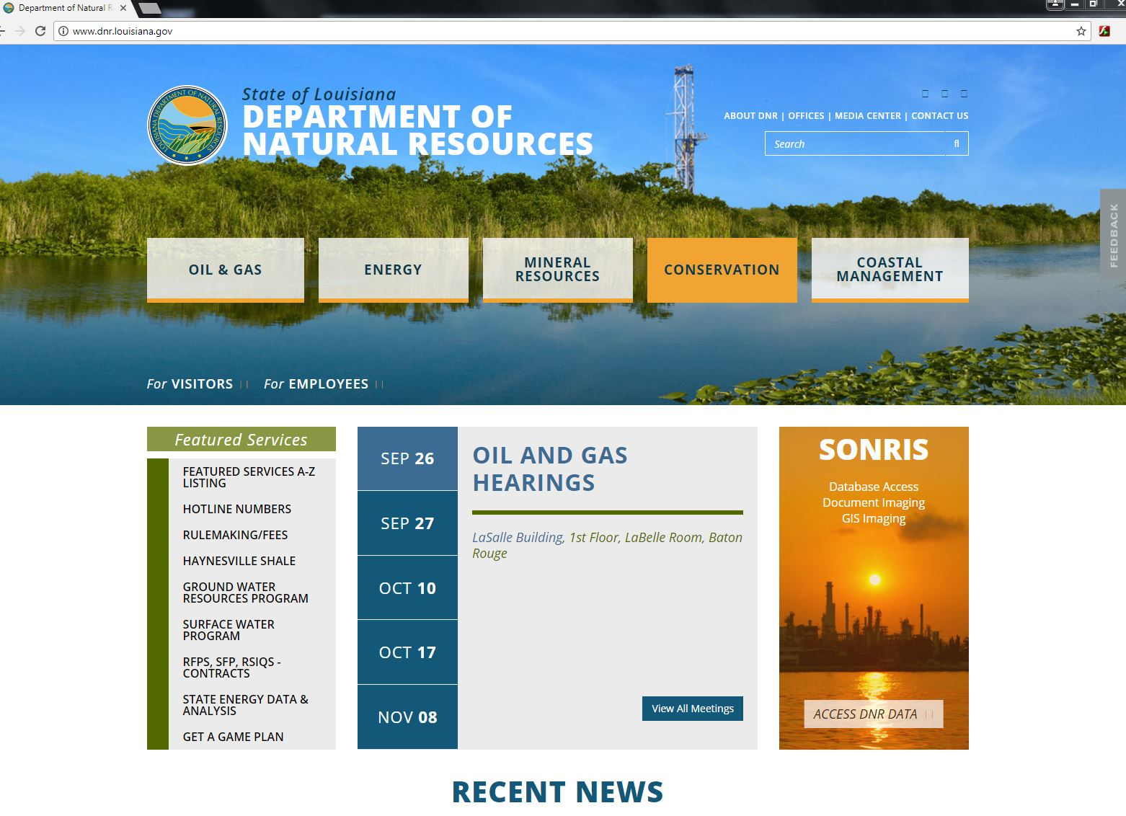
Website

Slide 22
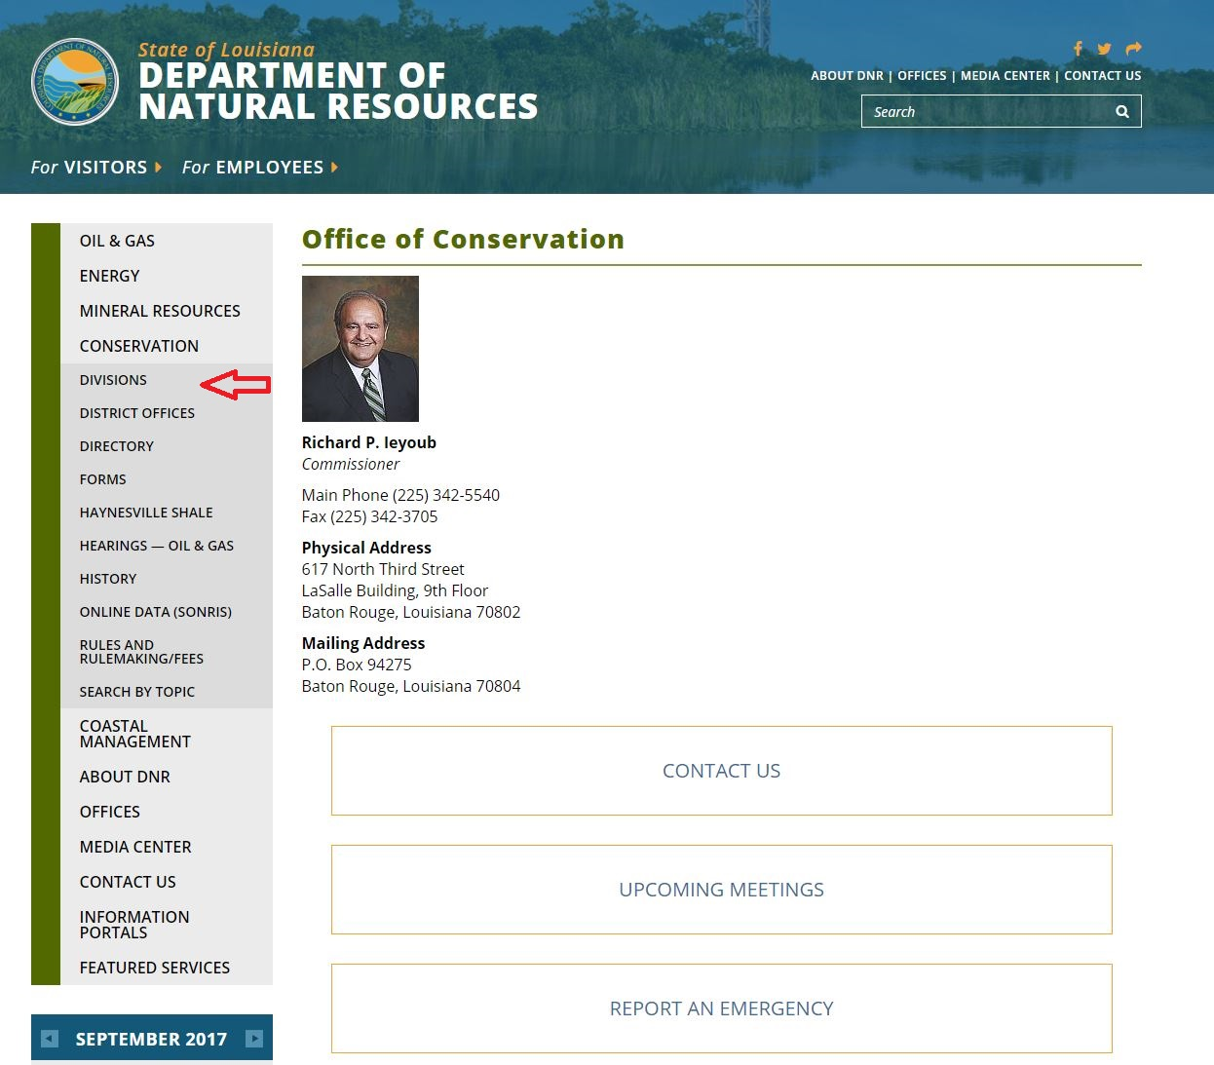
Website
22

Slide 23
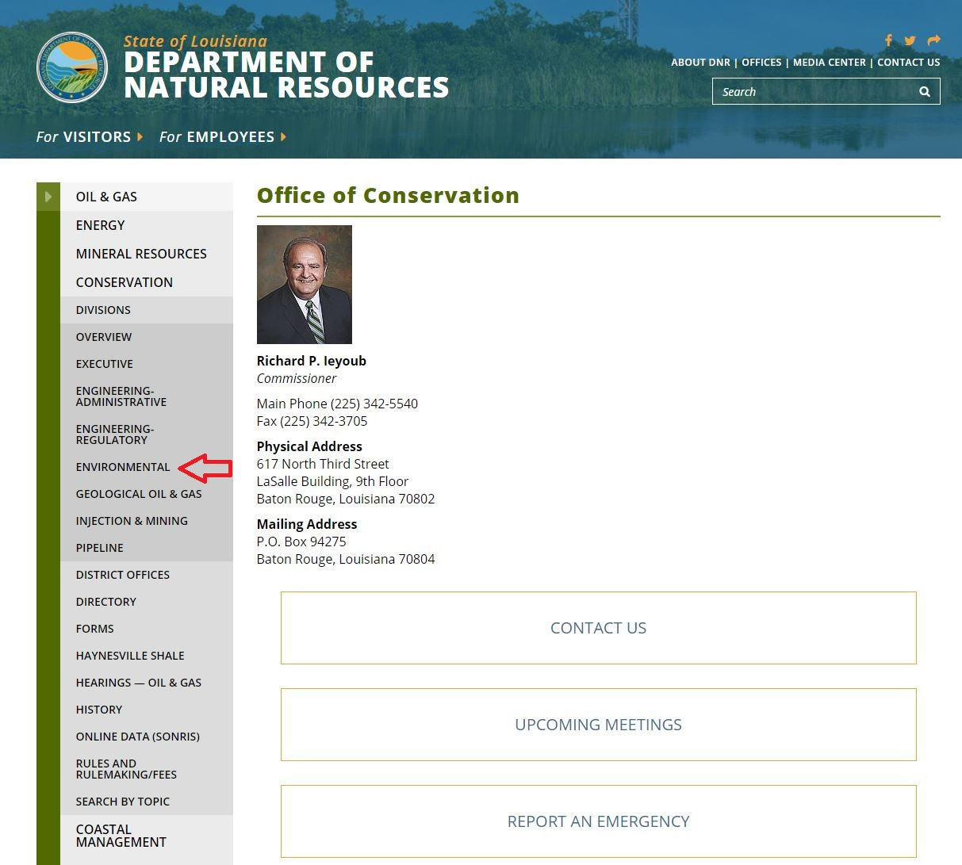
Website

Slide 24
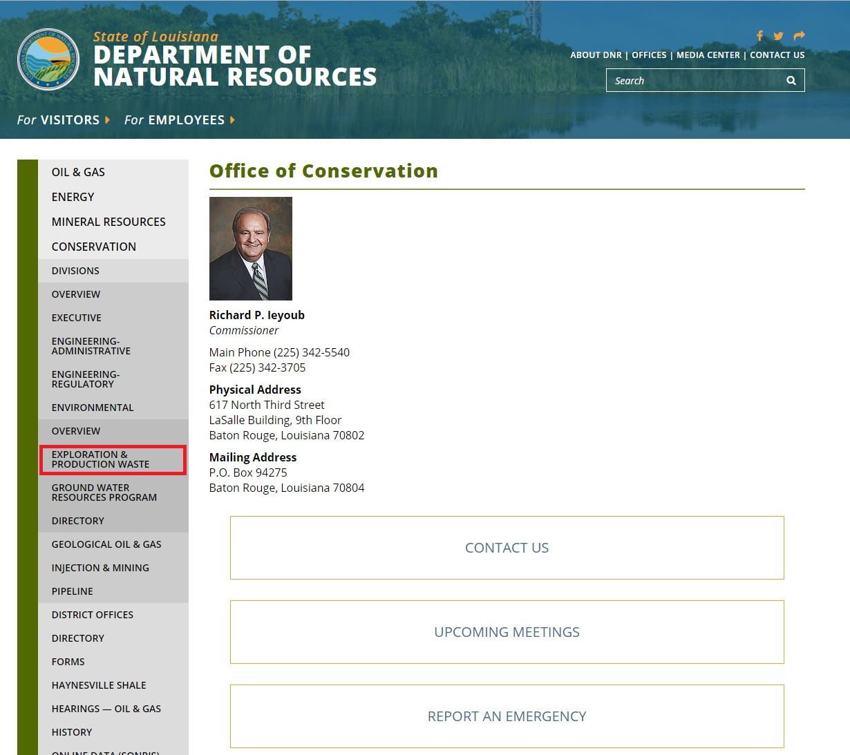
Website

Slide 25
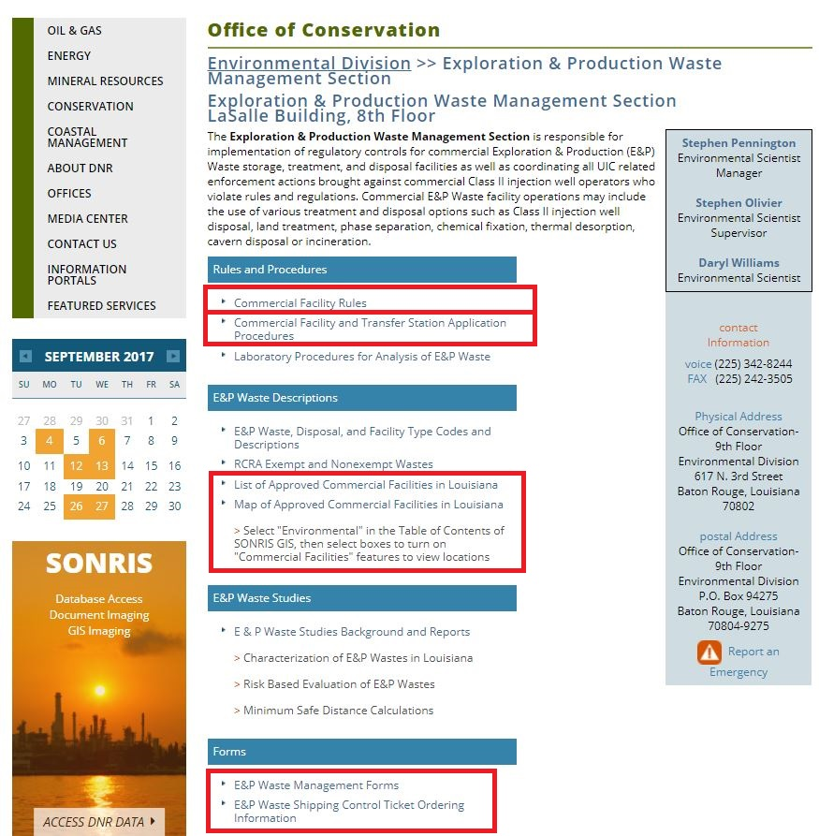
website

